Slide 1
22. Sept. 2007
32nd Intl. AES Conference “DSP for Loudspeakers”
Hillerod, Denmark
Application of Linear-Phase Digital Crossover Filters to Pair-Wise Symmetric Multi-Way Loudspeakers
Part 1: Control of Off-Axis Frequency Response
ULRICH HORBACH
Harman Consumer Group, Northridge, California, USA
D. B. (DON) KEELE, JR.
Harman/Becker Automotive Systems, Martinsville, Indiana, USA

Slide 2
Outline
Traditional Crossover Alignments
New Design Technique
  basic design
  control of low- and high frequency responses
  variation of design parameters
Implementation
  examples: 3,4,6 - way
  filter approximation
  driver equalization
  baffle diffraction effects

Slide 3
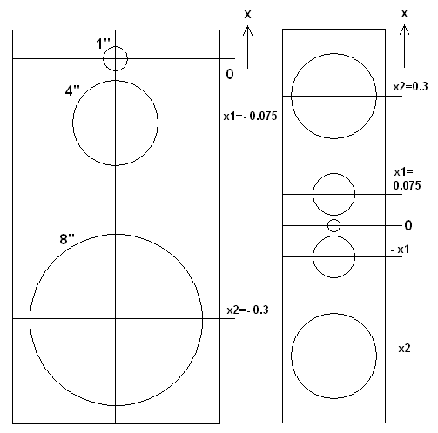
Traditional Crossover Alignments
asymmetric vs. symmetric
compute frequency responses using circular piston models
goal: smooth off-axis responses => constant directivity

Slide 4
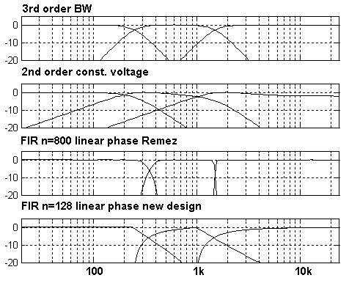
Traditional (and new) Crossover Alignments

Slide 5
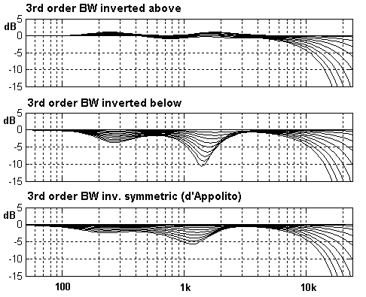
Traditional Crossover Alignments
3rd order BW with inverted midrange
vertical 0…45° above/ below tweeter axis/ symmetric layout

Slide 6
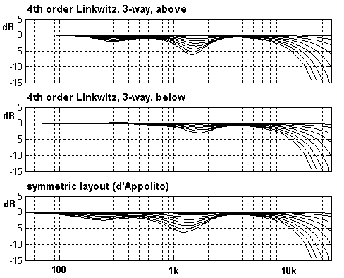
Traditional Crossover Alignments
4th order Linkwitz
not strictly symmetric because of woofer
no flat off-axis responses

Slide 7
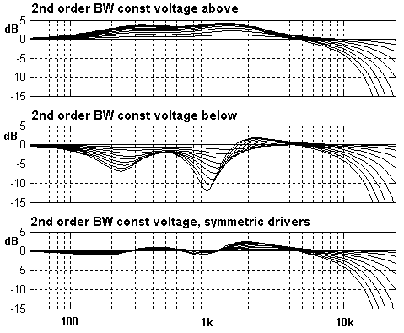
Traditional Crossover Alignments
2nd order constant voltage
works quite well in the symmetric case

Slide 8
Traditional Crossover Alignments
digital FIR crossover
latency 16msec
Lowpass
n=800
bass
-
Lowpass
n=800
mid
T=n/2
+
-
high
T=n/2
+

Slide 9
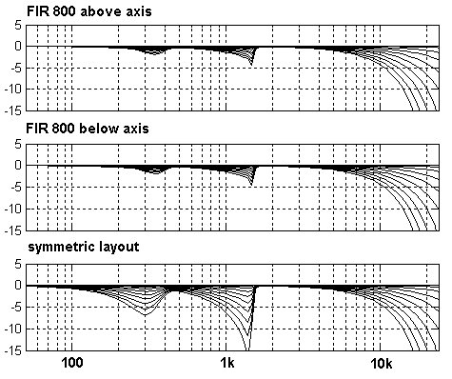
Traditional Crossover Alignments
n=800 but still not perfect
time smearing likely with effects present that cause non-ideal acoustic sum
symmetric layout not applicable

Slide 10
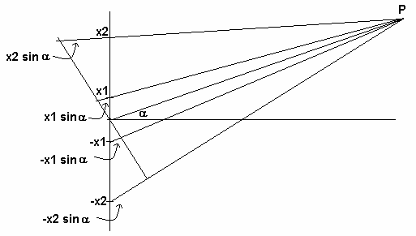
New Technique – Basic Design
Sound pressure of two monopole pairs at point P, crossed over using a filter pair with frequency responses w₁, and (1-w₁):

Slide 11

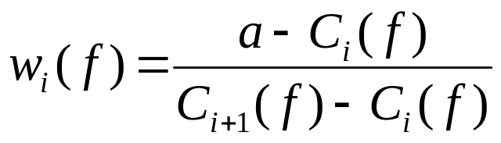

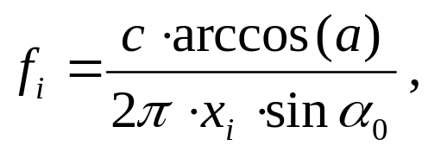
New Technique – Basic Design
Prescribe an attenuation a at an off-axis angle α₀ :
Compute the crossover function:
Setting
yields the frequencies where the lowpass reaches zero,
that are called “critical frequencies”

Slide 12
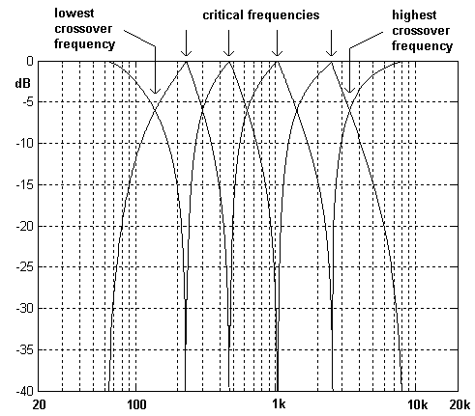
New Technique – Basic Design
6-way design example
crossover frequencies result from driver location data and prescribed attenuation at desired angle
max. two pairs of transducers are active at a given frequency point

Slide 13
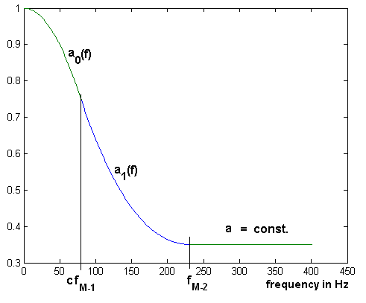
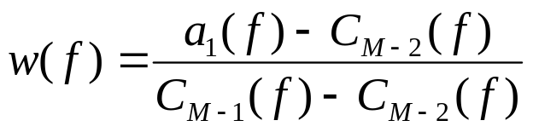
New Technique – Control of Low Frequency Responses
the frequency response below the lowest critical frequency is that of a pair of monopoles a₀(f) , approaching one at DC
prescribe a transitional frequency response a₁(f) using a spline function
(M – way design)

Slide 14
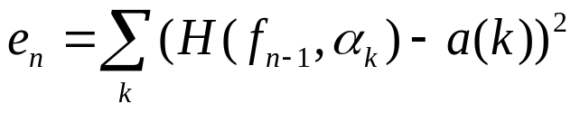
New Technique – Control of High Frequency Responses
minimize n errors at n frequency points
for k angles, with
one-parameter crossover filter optimization x(n) per frequency point n
includes a measured tweeter magnitude response H_{TW}

Slide 15
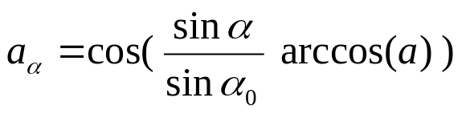
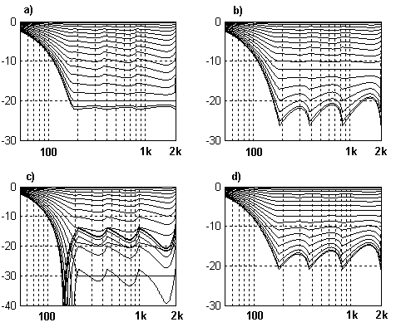
New Technique: Variation of Design Parameters
attenuation at an arbitrary angle is the same at all critical frequency points
6-way design
0…(5°)…90° shown
a) α=80°, a=-20dB
b) α=60°, a=-12dB
c) α=60°, a=-30dB
d) α=45°, a=-6dB

Slide 16
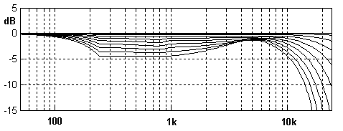
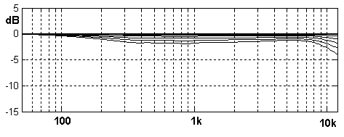
Implementation examples: 3/ 4-way
shown 0…5°…45°
x=[.3, .075]
α=45°, a=-4.5dB
f_{c}= 340/ 1500 Hz
x=[.4, .16, .06]
a=60°, a=-4.5dB
f_{c}= 160/ 500/ 1700 Hz

Slide 17
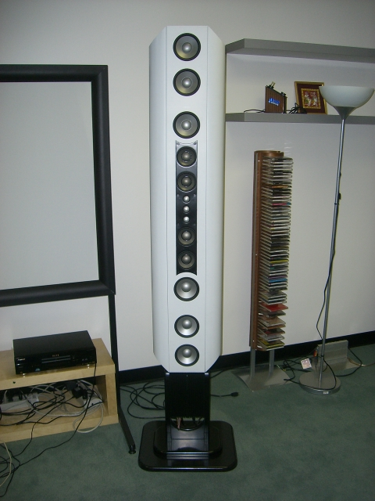
Implementation examples: 6-way

Slide 18
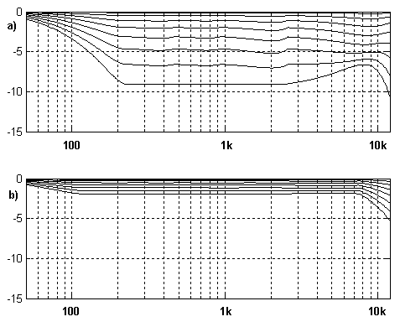
Implementation examples: 6-way
shown 0…5°…40°
x=[.7 .45 .22 .11 .048]
α=40°, a=-9dB
f_{c}= 160/ 300/ 600/ 1250/ 3200 Hz
α=40°, a=-2dB
f_{c}= 90/ 160/ 320/ 660/ 1600 Hz

Slide 19
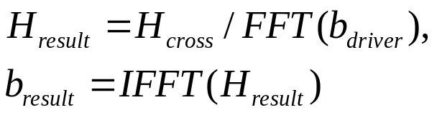
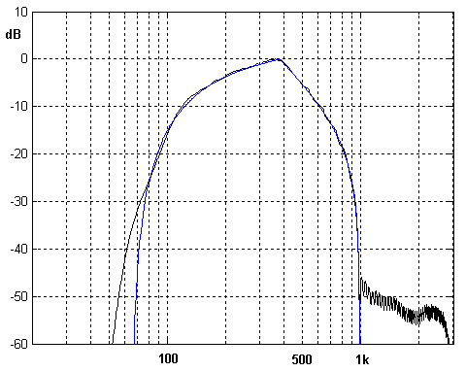
Implementation: Filter approximation and driver EQ
H_{cross} is real-valued (zero-phase)
in this example f_{s}=6kHz, n=128
no steep transition band => low filter degrees are possible

Slide 20
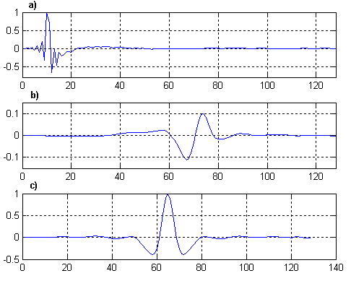
Implementation: Filter approximation and driver EQ
Measured driver impulse response
FIR crossover-EQ impulse response
resulting acoustic impulse response

Slide 21
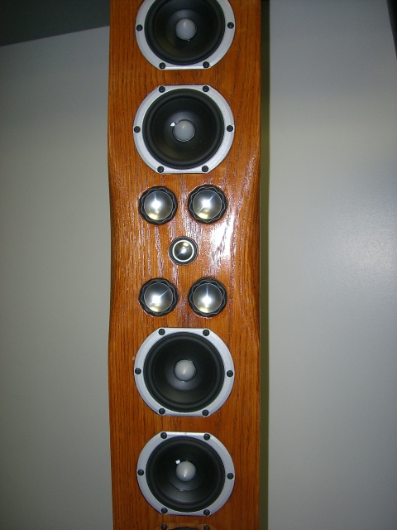
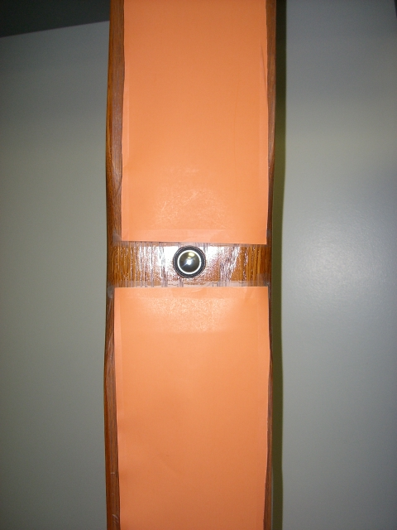
Implementation: Baffle diffraction effects

Slide 22
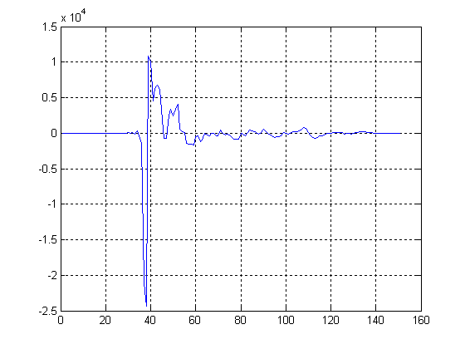
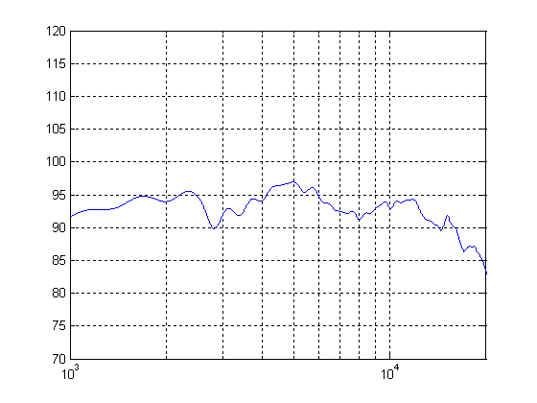
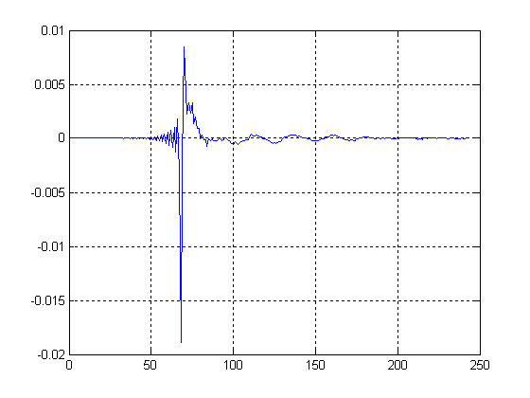
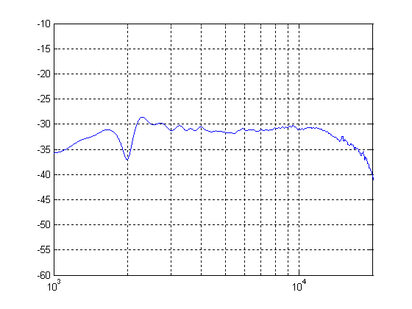
Implementation: Baffle diffraction effects
Diffraction caused by woofer cavities
with cardboard cover
angle-dependent effect => equalization is not advisable!

Slide 23
Final remarks
we presented a new class of digital crossover filters that allow the design of “perfect” multiway speaker systems
attention needs to be paid to effects that have previously been considered second order, like baffle diffraction caused by adjacent drivers
what has really happened in the loudspeaker industry over 30 years? See M. Tanaka et al, 63. AES convention, Los Angeles 1979 “An Approach to the Standard Sound Transducer”

